Slide 1
Memory Management in the D programming language
Ministerul Educaţiei şi Tineretului al Republicii Moldova
Universitatea Tehnică a Moldovei
Facultatea de Calculatoare, Informatică şi Microelectronică
Catedra Filiera Anglofonă
Student: Panteleev Vladimir, FAF-051
Adviser: Lect. Sup. Radu Melnic

Slide 2
D Programming Language

Slide 3
D Programming Language
Improved Features
New features
Templates
Design-by-contract
Unit testing
Automatic memory management
Classes

Slide 4
Automatic memory management
Object obj = new Object();
// ...
delete obj;

Slide 5
Reference Tracking
Heap
Garbage
Root set of references
Garbage
Garbage
Garbage

Slide 6
Problems solved by automatic memory management
“Classic” memory leaks
Memory corruption problems
Dangling pointer bugs
Double free bugs

Slide 7
Automatic memory management downsides
GC runs – unpredictable
All threads must stop
Conservative GCs may not destroy all objects

Slide 8
Garbage Collector Classification
Garbage Collectors
Reference Counting
Tracing
moving / non-moving
copying / mark-and-sweep / mark-and-don't-sweep
generational / non‑generational
stop-the-world / incremental
precise / conservative

Slide 9
Garbage Collector Classification
Garbage Collectors
Reference Counting
Tracing
moving / non-moving
copying / mark-and-sweep / mark-and-don't-sweep
generational / non‑generational
stop-the-world / incremental
precise / conservative

Slide 10
Memory Management in D

Slide 11
Runtime Interaction
C/C++
D
User Code
libc
Operating System
User Code
D runtime
Windows
libc
Linux/OS X

Slide 12
Memory layout
Memory is divided into pools (multiples of 64kB)
Pools are divided into pages (4kB each)
Pages are classified into bins

Slide 13
Memory layout
B_16
B_32
B_64
B_128
B_256
B_512
B_1024
B_2048
B_PAGE
B_PAGEPLUS
B_FREE
B_UNCOMMITTED

Slide 14
Memory layout
PAGE
PAGE_PLUS

Slide 15
Memory layout
MARK
SCAN
FREE
FINAL
NOSCAN

Slide 16
Memory layout
MARK
SCAN
FREE
FINAL
NOSCAN

Slide 17
Garbage collection

Slide 18
Garbage collection

Slide 19
Garbage collection

Slide 20
Garbage collection

Slide 21
Garbage collection

Slide 22
Garbage collection

Slide 23
Garbage collection

Slide 24
Analyzed Problems
Poor performance
Memory Leaks
Memory corruption

Slide 25
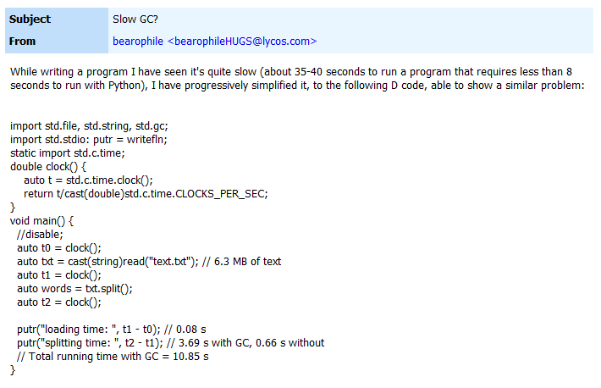
Poor Performance

Slide 26
Poor Performance

Slide 27
Poor Performance

Slide 28
Poor Performance

Slide 29
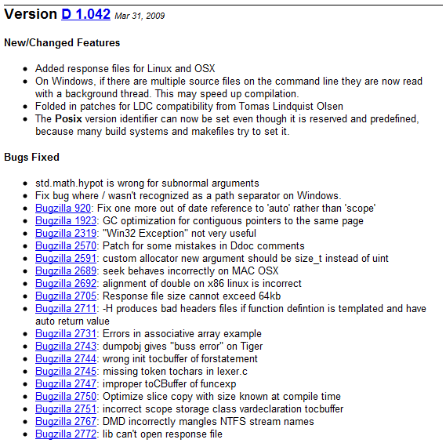
Poor Performance

Slide 30
Memory Leaks
Very different from “conventional” leaks
Usually mean that no memory is deallocated at all
No tools to debug them

Slide 31
Memory Leaks
…
0xC0580F1D
0x3612796C
0x8A6B3F92
0x8D6F85DB
0x4B0A8948
0x703DCE69
0xCAEB2C0E
…

Slide 32
Memory Leaks
…
0xC0580F1D
0x3612796C
0x8A6B3F92
0x8D6F85DB
0x4B0A8948
0x703DCE69
0xCAEB2C0E
…

Slide 33
Memory Leaks
M is block with pointers
N is block being referenced
For sizes of 1MB (2²⁰), P(M,N) ≈ 1

Slide 34
Memory Leaks
import std.stdio;
// ...
auto result = read("file1") ~ read("file2");

Slide 35
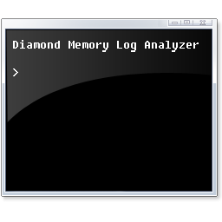
Diamond Memory Debugger
D module
Post-mortem log analyzer

Slide 36
Diamond Memory Debugger
D program
Diamond module
D garbage collector
Log file
Log analyzer

Slide 37
Diamond Memory Debugger

Slide 38
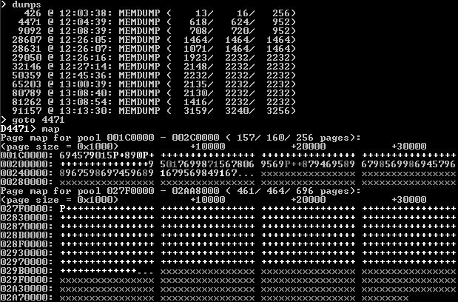
Diamond Memory Debugger

Slide 39
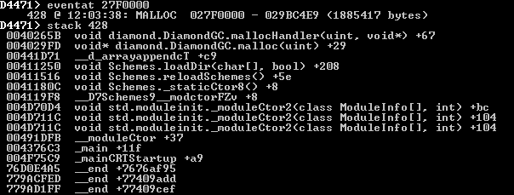
Diamond Memory Debugger

Slide 40
Memory corruption
Usually happens with manual memory management
Hard to debug
Symptoms manifest far from cause
Standard memory debugging tools do not apply for D

Slide 41
Double Free Bug
auto a = new ubyte[10];
auto b = a;
delete a;
delete b;

Slide 42
Dangling Pointer Bug
auto a = new int[5];
a[3] = 7;
auto b = a;
delete a;
writefln(b[3]);

Slide 43
Practical Applications
WebSafety scanner
Severe memory leak
Diamond reduced memory usage tenfold
Internet proxy
Severe stability problems due to memory leak
Diamond fixed memory leak, stability achieved

Slide 44
Practical Application: WebSafety Scanner

Slide 45
Practical Application: WebSafety Scanner

Slide 46
Practical Application: WebSafety Scanner

Slide 47
Practical Application: Internet Data Proxy

Slide 48
Practical Application: Internet Data Proxy

Slide 49
Diamond Memory Debugger
Free, open-source debugging tool
Unique – no similar tools exist for the D programming language
Can be downloaded for free from http://dsource.org/projects/diamond

Slide 50
Conclusion
Results of research have impact on the programming world of today
Automatic memory management in compiled languages is a relatively new area
More efficient garbage collectors can be written
There is more research to be done

